Slide 1
VPD Epidemiology
Massachusetts
January 10, 2025
Julie Coco, Epidemiologist II
Training & Internship Coordinator
Division of Epidemiology
Massachusetts Department of Public Health
305 South Street
Jamaica Plain, MA 02130-3597
Notes:
Good Morning PHNS! Thank you for coming to today’s talk; today we’ll be discussing the MMR; measles, mumps and rubella. Maybe not exactly in that order, but you get the point!
Let’s go ahead and get started;

Slide 2
Agenda
Pertussis Update
MMR
  Measles Case Investigations
  Mumps Case Investigations
  Rubella
Questions

Slide 3
Summary of Pertussis in Massachusetts 2024 as of 1/9/25
(2024 data are preliminary and subject to change)
980 investigations (including all species of Bordetella)
960 had a species identified
926/960 were identified as B. pertussis (96%)
  Other species identified included B. bronchiseptica (2%) and B. parapertussis (1.25%)
Of the 926 events identified as B. pertussis, 862 were classified as confirmed and 5 as probable (867 confirmed/probable = 94% of reported B. pertussis events)
  41 were revoked – 18 remained suspect
Of the 867 confirmed and probable B. pertussis events:
  53% female and 47% male
  Mean age = 16.667
  Median age = 15.939
  Although we have some issues with completeness of symptom variable reporting in MAVEN, for those
  with complete reporting, over 40% of cases reported paroxysmal cough, over 30% reported post-tussive vomiting and over 24% reported the “whoop” sound.
  27 hospitalizations reported with vast majority (800/867) reporting no hospitalization
  Similarly, “recovered” was indicated for 98% of patients reporting an outcome.
  There were no deaths reported.
Notes:
Why might a species not have been identified? Example: provider suspects pertussis and a case is entered into MAVEN, but testing is not done or results are not positive. Many of these events are revoked or remain suspect.

Slide 4
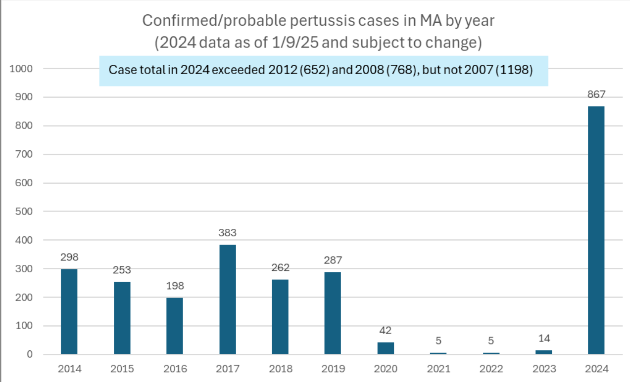

Slide 5
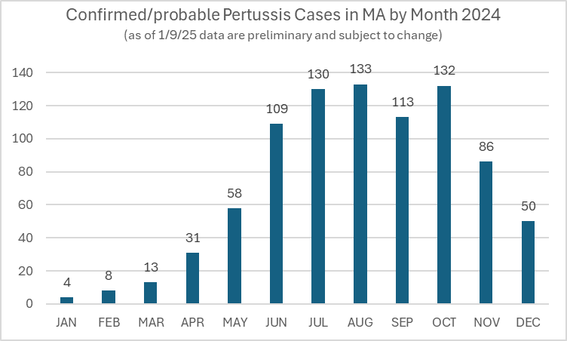

Slide 6
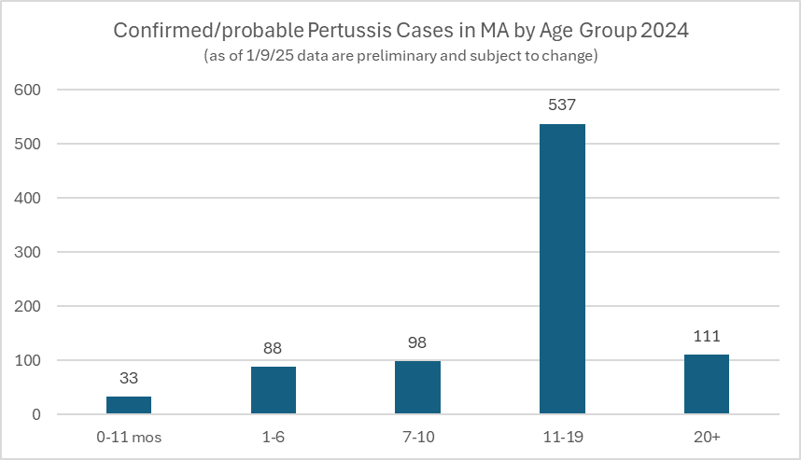

Slide 7
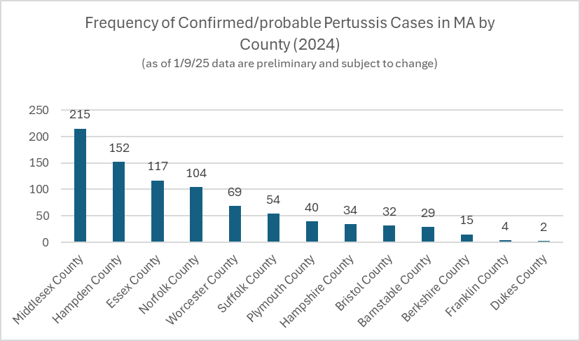

Slide 8
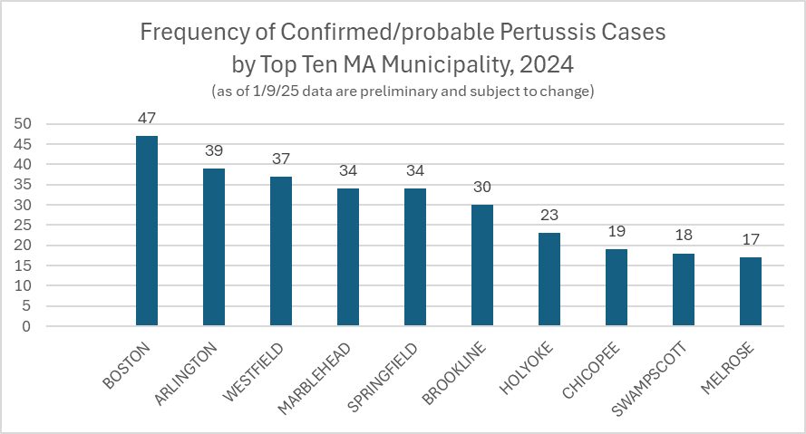

Slide 9
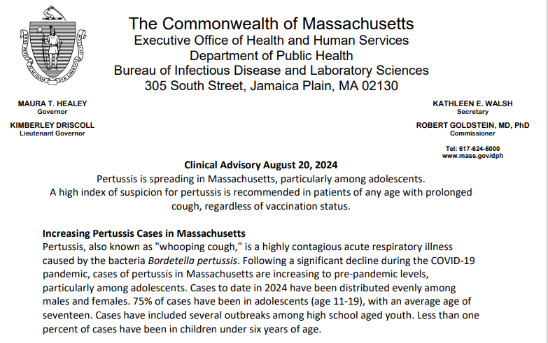
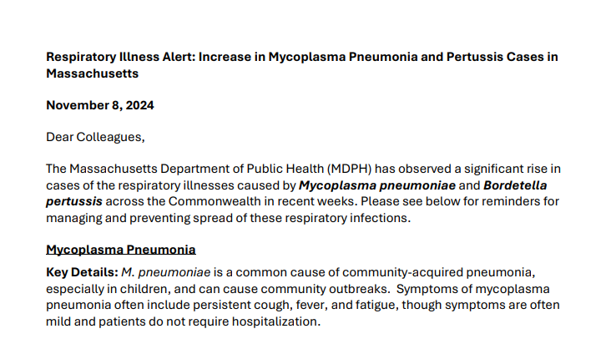

Slide 10
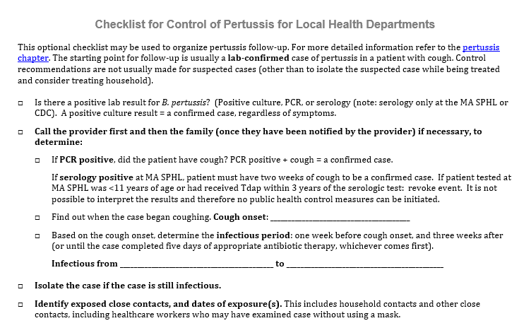
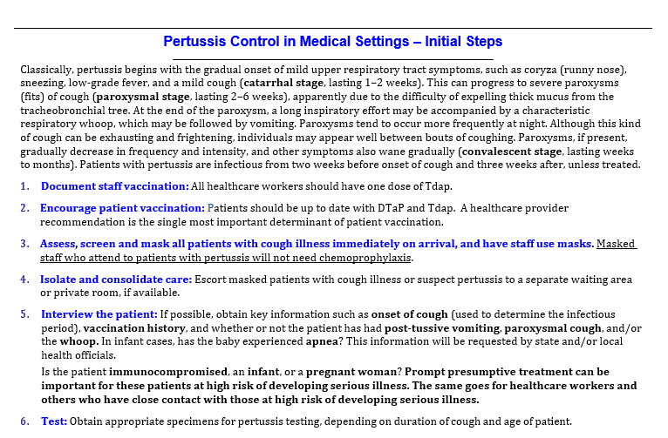
Resources
Pertussis Chapter https://www.mass.gov/handbook/guide-to-surveillance-reporting-and-control

Slide 11
Group Question!
What are you noticing with pertussis investigations?
What questions do you have?

Slide 12
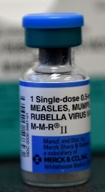
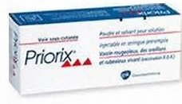
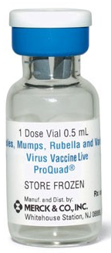
Measles, Mumps, and Rubella (MMR) Vaccination
Measles Vaccine
There are now TWO MMR vaccines available for use in US!
  KEY UPDATE: Both vaccines are fully interchangeable for all indications for which MMR vaccination is recommended:
M-M-R II manufactured by Merck (Previous only US option available since 1978)
PRIORIX manufactured by GSK (Licensed June 2022)
MMRV Combination Vaccine: Children may also get MMRV (measles, mumps, rubella, & varicella) licensed for use 12 months through 12 years of age.
    ProQuad manufactured by Merck (MMRV licensed 2005)
CDC MMWR: MMR Vaccine (PRIORIX) ACIP Recommendations Nov. 18, 2022.
Notes:
The MMR vaccine protects against measles, mumps, and rubella. It contains live, attenuated viruses for each disease. The vaccine is typically given to children in two doses, with the first dose administered at 12–15 months and the second at 4–6 years. The MMR vaccine is highly effective, providing long-term immunity against these diseases. There are interchangeable versions of the MMR vaccine, with different manufacturers offering vaccines that are essentially equivalent in composition and effectiveness. T

Slide 13

MMR Vaccine – Protection While You Travel!
Measles Vaccine
Children ages 6–11 Months can receive one dose of MMR vaccine prior to travel for temporary increased protection from measles!
  ACIP recommends that children who travel or live abroad should be vaccinated at an earlier age than that recommended for children who reside in the United States. The risk for measles exposure can be high in high-, middle- and low-income countries.
  A measles-containing vaccine administered more than 4 days before the first birthday should NOT be counted as part of the US Immunization Schedule series.
    The MMR dose should be repeated when the child is age 12 through 15 months (12 months if the child remains in an area where disease risk is high). The second dose should be administered at least 28 days after the first dose
Notes:
Children aged 6–11 months can receive one dose of the MMR vaccine prior to international travel for temporary protection against measles. The ACIP recommends that children who travel or live abroad be vaccinated earlier than the standard U.S. schedule, as the risk of measles exposure is higher in many countries. However, a measles-containing vaccine given before the child’s first birthday (more than 4 days early) does not count as part of the U.S. Immunization Schedule. A second dose should be given at age 12–15 months (at least 28 days after the first dose) to ensure full protection, especially if the child remains in a high-risk area.

Slide 14
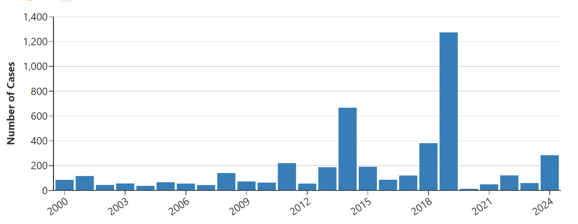
Measles Outbreaks in the U.S.
In any given year, more measles cases can occur for any of the following reasons:
  an increase in the number of travelers who get measles abroad and bring it into the U.S., and/or
  further spread of measles in U.S. communities with pockets of unvaccinated people.
Number of US Measles Cases Reported by Year
2000-2024* (as of December 20, 2024)
https://www.cdc.gov/measles/cases-outbreaks.html
Notes:
From 2000-2024, measles cases in the U.S. were largely eliminated due to high vaccination rates, but outbreaks occurred, notably in New York City (2019) and Ohio (2014), primarily driven by unvaccinated populations. The majority of U.S. outbreaks stemmed from travelers contracting measles in countries with endemic transmission and then spreading it domestically. These outbreaks emphasize the importance of vaccination, as unvaccinated individuals remain susceptible, particularly in communities with lower immunization coverage. The U.S. continues efforts to maintain herd immunity to prevent re-establishment of endemic measles.

Slide 15
Measles in Massachusetts
Measles Morbidity
Total Confirmed Measles Cases and Measles Investigations*
*Data as of 12/31/2024
Note: Imported cases (AKA travelers who may visit MA while infectious) do not reside in MA and therefore are not included in the table above.
As you can see, most suspect cases for measles are eventually ruled out, however even one case can lead to several hundred exposures and extensive follow-up.
 | 2014 | 2015 | 2016 | 2017 | 2018 | 2019 | 2020 | 2021 | 2022 | 2023 | 2024*
CONFIRMED MEASLES | 8 | 0 | 1 | 0 | 2 | 3 | 1 | 0 | 0 | 0 | 1
Total Investigations | 111 | 119 | 62 | 55 | 74 | 196 | 24 | 16 | 17 | 38 | 84
Notes:
Even when a measles case is reported and ultimately turns out to be negative, it still requires significant resources for investigation. Health officials must rapidly assess the situation, including contact tracing, notifying potential exposure sites, and determining risk to vulnerable populations. Epidemiologic investigations often involve reviewing vaccination records, interviewing healthcare providers, and tracing the movements of the individual. This process can take hours of manpower, involve multiple public health teams, and strain resources. Additionally, public health communications may be required to reassure the public or manage misinformation. Even negative cases highlight the importance of preparedness and swift response to potential outbreaks.

Slide 16
Group Question!
What measles situations have you seen (suspect cases, revoked, confirmed)?
How did you interact with Division of Epidemiology?
What was your role?
What are your questions?

Slide 17
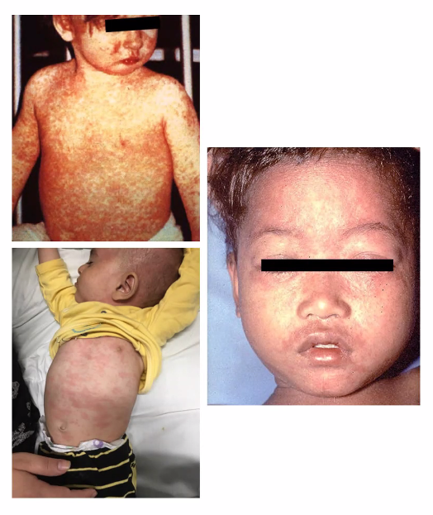
Measles: Symptoms
Measles Background
Viral disease characterized by fever, cough, runny nose (coryza), conjunctivitis, erythematous maculopapular rash, and characteristic mouth lesions (Koplik spots)
  Fever typically increases in stepwise fashion, peaking as high as 103° - 105° F
  Rash classically begins at the hairline, then involves the face and upper neck.
  Gradually proceeds downward over the next few days, reaching the hands and feet.
    The rash fades in the same order that it appears, from head to the extremities (usually lasts 5–6 days).
Rash begins approx. 14 days after exposure.
Maculopapular
Head to toe progression
Notes:
Measles symptoms begin with a prodrome phase, typically 10-12 days after exposure. This phase includes fever, cough, runny nose, red eyes (conjunctivitis), and sore throat. A distinctive feature is the appearance of Koplik spots, small white lesions inside the cheeks, usually 2-3 days before the rash. The rash itself starts 3-5 days after the prodrome, typically behind the ears and on the face, then spreads downwards to the torso and limbs. It appears as red, blotchy spots that may merge into larger patches. A fever typically increases in stepwise fashion; peaking as high as 105 degrees Fahrenheit.

Slide 18
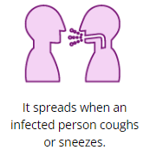
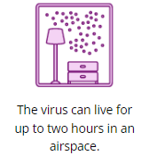
Measles: Transmission
Measles Background
A Respiratory Virus: Measles is a highly contagious virus that lives in the nose and throat mucus of an infected person. It can spread to others through coughing and sneezing.
  If other people breathe the contaminated air or touch the infected surface, then touch their eyes, noses, or mouths, they can become infected.
  Animals do not get or spread measles.
Measles is one of the most contagious diseases!
  Measles is so contagious that if one person has it, up to 90% of the people close to that person who are not immune will also become infected.
  Measles virus can live for up to two hours in an airspace after an infected person leaves an area.
Infectious Period: Infected people can spread measles to others from four days before through four days after the rash appears.
https://www.cdc.gov/measles/transmission.html
Notes:
Measles is a highly contagious respiratory virus that spreads through coughing, sneezing, and contact with nasal or throat mucus from an infected person. The virus can remain airborne for up to two hours after the infected person leaves an area, and others can become infected by breathing contaminated air or touching surfaces and then touching their eyes, nose, or mouth. Animals do not spread measles. It is so contagious that up to 90% of unvaccinated individuals close to an infected person can contract the virus. The infectious period lasts from four days before to four days after the rash appears.

Slide 19
A True Measles Story!
MDPH Investigated a measles case in a child <1 yr of age to determine the source of infection. Conclusion: while on vacation in the Caribbean, the MA family had stayed at a hotel on an island. In the next room, travelers from France were also staying as guests. One of the French travelers became sick with measles while staying at the hotel – and infected the child next door without ever interacting directly!
Measles virus can travel in shared air spaces!
Notes:
MDPH Investigated a measles case in a child <1 yr of age to determine the source of infection. Conclusion: while on vacation in the Caribbean, the MA family had stayed at a hotel on an island. In the next room, travelers from France were also staying as guests. One of the French travelers became sick with measles while staying at the hotel – and infected the child next door without ever interacting directly!

Slide 20
Evidence of Immunity for Measles
Measles Prevention
VACCINE RECORD: Documentation of 2 appropriately timed doses of measles containing vaccine; or
LAB TEST: Serologic evidence of immunity or laboratory evidence of disease; or
AGE: Birth in the US before 1957 (unless a healthcare worker)
Past history of disease is NOT acceptable evidence of immunity without a lab test.
Foreign-born individuals (including those born before 1957) should have documentation of immunization or serologic evidence of immunity. Those who are born before 1957 can be assigned a lower priority for follow up.
Quarantine for Susceptible Contacts: Day 5 through Day 21 Following Exposure. (Exposure = Day 0)
Not sure if someone was previously vaccinated? There is no harm in giving MMR vaccine to a person who may already be immune to one or more of the vaccine viruses.
Notes:
Immunity to measles can be documented through:
Vaccine Record: 2 appropriately timed doses of measles-containing vaccine.
Lab Test: Serologic evidence of immunity or lab confirmation of past disease.
Age: Birth in the U.S. before 1957 (except for healthcare workers).
Note: Past history of disease is not acceptable without lab test confirmation. Foreign-born individuals, including those born before 1957, must provide immunization records or serologic evidence. Individuals born before 1957 may have lower priority for follow-up.

Slide 21
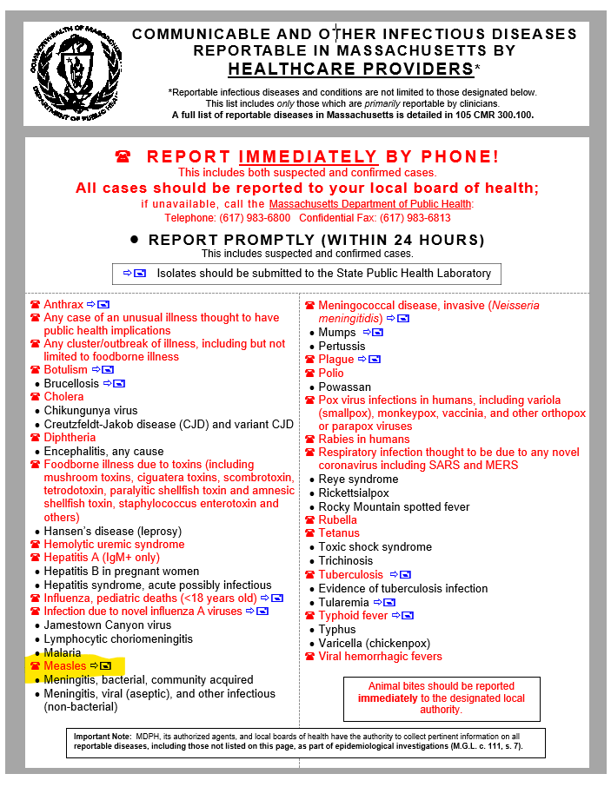
Measles Testing: Notes for LBOH
Measles Testing
Measles is an Immediate Disease. All suspected measles cases should be reported to MDPH by the provider wishing to test to ensure the proper specimens are collected and public health is ready to implement appropriate control measures and follow-up as soon as possible.
Most MAVEN Events for Measles will be created by an MDPH Epi as Suspect Events while the test results are pending. Test results are typically available within 24-48 hours, but follow-up activities may be initiated sooner in highly suspect situations.
Partner with MDPH. Be sure to be in communication with the assigned epi to receive the results and to ensure appropriate and timely local response as needed.
Notes:
Measles is an immediate reportable disease. All suspected cases should be promptly reported to the Massachusetts Department of Public Health (MDPH) by the provider, ensuring the proper specimens are collected and public health is prepared to implement control measures. Most MAVEN events for measles are created by MDPH epidemiologists as Suspect Events while test results are pending, which usually take 24-48 hours. However, follow-up activities may begin sooner if measles is highly suspected. It is crucial to communicate with the assigned epidemiologist to receive test results and ensure timely, appropriate local responses to control the outbreak.

Slide 22
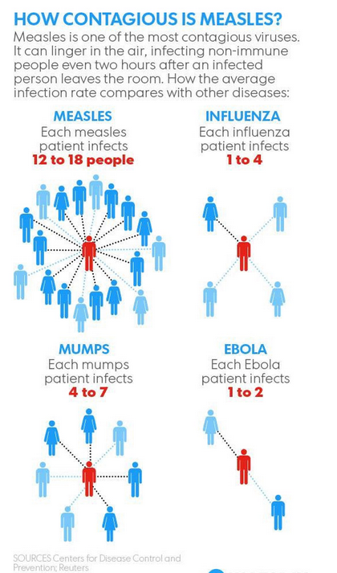
Measles Control Measures
Measles Control Measures
Isolate & Interview Cases
Identify Contacts
Are Contacts Immune or Susceptible?
Is Post-Exposure Prophylaxis Recommended?
Quarantine Contacts
Notes:
Control measures:
Isolate & Interview Cases
Identify Contacts
Are Contacts Immune or Susceptible?
Is Post-Exposure Prophylaxis Recommended?
Quarantine Contacts

Slide 23
Isolate All Suspect Cases
Measles Control: Isolation
Infectious Period: 4 days before rash through 4 days after rash onset.
Isolate case through 4 days after rash onset.
  Onset of Rash= Day 0
  If in a health care facility, the patient should be kept on airborne precautions.
    Remember, shared air space up to 2 hours after a case was present can lead to exposure.
Rash Onset
Day −4
Day −3
Day −2
Day −1
Day 0
Day +1
Day +2
Day +3
Day +4
Infectious Period
Notes:
The infectious period for measles begins 4 days before the rash appears and continues through 4 days after rash onset. During this time, patients should be isolated, with isolation continuing for 4 days after the rash appears. The onset of the rash is considered Day 0. If the patient is in a healthcare facility, they should be placed on airborne precautions to prevent transmission. It's important to remember that shared airspace can remain infectious for up to 2 hours after the patient leaves the area, so any individuals in the space during that time are at risk of exposure.

Slide 24
Thoroughly Interview Case (or Family of Child)
Case Interview
Key Questions to ask the Patient
Symptom History (Review the symptoms experienced, rash onset date is critical) (QP #3)
MMR Vaccination History (if not already known from ordering provider)? (QP #4)
Occupation/school (if so, where and did they work/attend school while infectious)? (QP #2)
Race/Hispanic Status (if not known by provider)?
Risk History
  Contact with another case of measles, or someone with similar symptoms? (QP #5)
  Travel History (including where and dates), or recent out of town visitors (from where and dates)? (QP #5)
    Flights while infectious? Obtain Flight Info.
  Transmission setting (childcare, school, healthcare setting)? (QP #5)
Risk History Time Period is generally 3 weeks (up to 21 days) prior to onset so we can hopefully determine where they may have been exposed to measles (risk history).
Notes:
Yes, typically there will already be some notes in the case from the epi who created it and spoke with the provider. But even if some of the information you need was already collected, it is important to re-ask the patient about their symptoms and risk. They may have a different answer than the provider. Sometimes what the provider said was a rough estimate, and you will have better luck getting exact dates and information from the patient directly. The providers don’t always ask their patients the right questions, and often the patient has already gone home by the time the doctor is calling the health department. So we at least need you to confirm the rash onset dates directly.

Slide 25
Identify Close Contacts
Measles Control:
Contact Identification
Those individuals present at the same time as the case in a shared airspace, as well as in the determined airspace for 2 hours after the case left:
  Household
  Close friends
  School or daycare (students and staff)
  Medical facility (patients and staff)
  Workplace
  Religious/social groups
  Sports teams or other extracurricular activity groups
  Buses/Carpools/Taxis/Ubers, etc.
  Travel (companions and drivers)
  Persons exposed at social events or retail establishments
The most common locations of exposure include household and medical facility settings (from when the patient sought care prior to diagnosis).
Don’t forget to ask how the patient got to and from various locations while infectious.
Notes:
Individuals who are in the same airspace as a measles case, including the shared space for up to 2 hours after the case leaves, are at risk of exposure. These include household members, close friends, school or daycare attendees (students and staff), and medical facility patients and staff. The most common exposure locations are households and healthcare settings. It’s important to ask how the patient traveled to and from these locations while infectious. Other potential exposure sites include workplaces, religious or social gatherings, sports teams, buses, carpooling, taxis, rideshare services, and travel companions at social events or retail locations.

Slide 26
Contact Notification
Measles Control:
Contact Notification
Identify and notify all exposed contacts of the case while the case was infectious.
  Phone calls
  Letters
  Public advisories
Prioritize high-risk contacts and refer them to their healthcare providers immediately for possible use of IG.
  Pregnant women
  Immunosuppressed individuals
  Infants <12 months of age
Ensure that companions of known exposed contacts, who have also been exposed, are identified.
  Examples: a medical office might have a list of patients that were in the waiting room, but family/companions that accompanied the patients would not be on their list.
Notes:
It is essential to identify and notify all individuals exposed to a measles case during its infectious period. Notification methods include phone calls, letters, and public advisories. High-risk contacts, such as pregnant women, immunosuppressed individuals, and infants under 12 months, should be prioritized and referred to healthcare providers for possible administration of immune globulin (IG).
Additionally, ensure that companions of exposed contacts, who may also be at risk, are identified. For example, a medical office may have a list of patients in the waiting room, but family members or companions who were with them might not be documented and should be contacted. Medical facilities are responsible for providing a line list of all exposed patients to MDPH

Slide 27
Identifying Close Contacts - Challenges
Measles Control:
Contact Notification
Some exposures may occur in locations where individual contact identification is not possible:
  Examples: Retail Establishments, Public Transportation, Public Spaces.
  Sometimes there are clear groups that can be targeted (like staff that worked during a particular timeframe or a list of patients that were in a waiting room).
  Other times we may have to rely on broader outreach so that potentially exposed individuals can self-identify.
You may need to work with an establishment to post a General Notice or Advisory with recommendations for next steps if someone believes they may have been at a particular location during a designated time period.
  Remember to add 2 hours on to the timeframe in question to ensure comprehensive outreach.
    For example, if a case reported shopping in Target from 2:00-2:15 pm, you would want to provide a general advisory for anyone who may have been in the facility from approximately 2:00-4:15 pm.
    MDPH Epi will help with these advisories and verifying timeframes/dates.
Notes:
Exposures may occur in locations where identifying individual contacts is not possible, such as retail establishments, public transportation, or public spaces. In some cases, targeted groups can be identified, such as staff working during a specific timeframe or patients in a waiting room. Other times, broader outreach is needed to allow potentially exposed individuals to self-identify. Collaborating with establishments to post general notices or advisories is essential for informing the public. Always add 2 hours to the exposure timeframe to ensure comprehensive outreach. For example, if a case was in Target from 2:00-2:15 pm, extend the advisory to 2:00-4:15 pm.

Slide 28
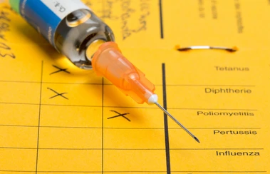
Are Contacts Immune or Susceptible?
Measles Control:
Assessing Immunity
Exposed individuals should immediately be assessed for immunity.
VACCINE RECORDS: Finding historical vaccination records may be challenging for some contacts, particularly those who may have been vaccinated prior to electronic medical records and/or electronic immunization registries.
  Tips for finding records include:
    Calling PCPs, parents, school/college health offices, old baby books/records, recently visited travel clinics (where MMR status might have been assessed?), etc. Check MIIS or other state registry.
Official Evidence of Immunity
VACCINE RECORD: Documentation of 2 appropriately timed doses of measles containing vaccine; or
LAB TEST: Serologic evidence of immunity or laboratory evidence of disease; or
AGE: Birth in the US before 1957 (unless a healthcare worker)
Notes:
Exposed individuals should be immediately assessed for immunity to measles. Finding vaccination records may be challenging, especially for those vaccinated before electronic medical records or immunization registries were common. To locate records, try contacting primary care providers, parents, school or college health offices, or travel clinics where MMR status may have been reviewed. Checking the Massachusetts Immunization Information System (MIIS) or other state registries can be helpful. Official evidence of immunity includes two appropriately timed MMR vaccine doses, lab test results, or age (individuals born before 1957 are generally considered immune). Prompt assessment ensures proper follow-up and control measures.

Slide 29
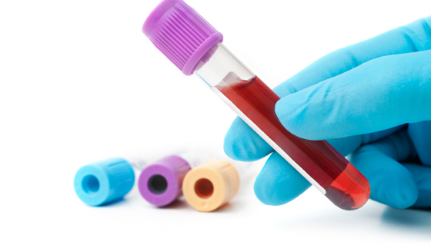
Are Contacts Immune or Susceptible?
Measles Control:
Assessing Immunity
Exposed individuals should immediately be assessed for immunity.
LAB TESTS: Obtaining a titer to assess immunity may be an option for individuals who lack vaccination records but are fairly confident they are immune.
  Things to consider include:
    Not all serologic titers may be covered by insurance.
    Timing following exposure (ensuring the titer is reflective of previous status and not acute illness). Sooner is better!
      Is the contact currently symptomatic?
    Titers following exposure may not eliminate the need to quarantine.
  Getting a dose of MMR at the same visit is often advised.
Official Evidence of Immunity
VACCINE RECORD: Documentation of 2 appropriately timed doses of measles containing vaccine; or
LAB TEST: Serologic evidence of immunity or laboratory evidence of disease; or
AGE: Birth in the US before 1957 (unless a healthcare worker)
Notes:
Exposed individuals should be assessed for immunity, and obtaining a serologic titer may help determine immunity for those without vaccination records but confident they are immune. Considerations include insurance coverage for serologic testing and the timing of the test to ensure it reflects prior immunity rather than acute illness—sooner testing is preferred. Also, assess whether the contact is symptomatic, as titers may not rule out the need for quarantine. If appropriate, administering an MMR dose during the same visit is often recommended, especially if immunity is uncertain. This approach ensures proper protection and management after exposure.

Slide 30
Post-Exposure Vaccine & Immune Globulin
Measles Control:
Post-Exposure MMR & IG
Identify close contacts who do not have evidence of immunity and recommend MMR or immune globulin (IG).
  Vaccination: Measles vaccine given within 72 hours of exposure may prevent disease.
    Beyond 72 hours, vaccine is still recommended to provide protection against exposure to future cases of measles.
    MDPH can help coordinate MMR vaccine supply for certain outbreak situations.
  Immune Globulin: IG may prevent or modify measles in persons who are nonimmune, if given within 6 days of exposure.
    This is typically recommended for individuals who are at risk for severe disease and complications from measles (e.g., infants <12 months of age, pregnant women without evidence of measles immunity, and severely immunocompromised persons regardless of vaccination status because they might not be protected by the vaccine)
Notes:
Identify close contacts without evidence of immunity and recommend either the MMR vaccine or immune globulin (IG). Measles vaccine given within 72 hours of exposure may prevent the disease, but beyond 72 hours, it is still recommended to provide protection against future exposure. MDPH can assist with coordinating MMR vaccine supply during outbreaks. Immune Globulin (IG), when administered within 6 days of exposure, can prevent or modify measles in nonimmune individuals. IG is recommended for those at higher risk of severe complications, such as infants under 12 months, pregnant women without immunity, and severely immunocompromised persons, regardless of vaccination status.

Slide 31
Quarantine Contacts
Measles Control:
Quarantine
Exclude susceptible close contacts unable to be vaccinated, or not vaccinated quickly enough, from day 5 through day 21 after exposure
  In most low-risk settings, susceptible close contacts may be readmitted immediately after they receive a dose of MMR, even when given >5 days post exposure. (local discretion)
  Susceptible close contacts who receive IG (instead of vaccine) should quarantined.
Measles Quarantine
Day 0 | Day 1 | Day 2 | Day 03 | Day 04 | Day 05 | Day 06 | Day 07 | Day 08 | Day 09 | Day 10 | Day 10 | Day 11 | Day 12 | Day 13 | Day 14 | Day 15 | Day 16 | Day 17 | Day 18 | Day 19 | Day 20 | Day 21 | Day 22
Exposure
Day 0
Quarantine
Day 5-21
Notes:
Any nonimmune person exposed to measles who received IG should subsequently receive MMR vaccine, which should be administered no earlier than 6 months after IGIM administration or 8 months after IGIV administration, provided the person is then aged ≥12 months and the vaccine is not otherwise contraindicated.
Susceptible close contacts who cannot be vaccinated or were not vaccinated quickly enough should be excluded from day 5 through day 21 after exposure. In most low-risk settings, individuals who receive the MMR vaccine (even after five days) may be readmitted immediately, though local discretion may apply. However, susceptible close contacts who receive immune globulin (IG) instead of the vaccine should remain quarantined for the duration of the incubation period (up to 21 days) to prevent the spread of measles. Ensuring proper exclusion and timely vaccination or IG administration is crucial in controlling outbreaks.

Slide 32
Notes on Exposure Follow-up: If Symptoms Develop
No Asymptomatic Testing. Contacts without symptoms should NOT be tested for measles. Only symptomatic contacts need to seek testing.
Testing for Measles? Avoid additional exposures at the medical office by calling ahead to arrange testing.
  Symptomatic contacts should be masked when seen.
  Attending providers should all have evidence of immunity and wear appropriate PPE.
  Pre-arrange a time when exposing other staff/patients can be minimized (before opening/after closing).
  Meet the patient at the door and immediately mask them to prevent the generation of droplets.
  Escort the patient through a separate entrance to a private waiting area or exam room, preferably a negative pressure room.
  Be creative. Consider collecting a specimen outside/through car window.
Notes:
Asymptomatic contacts should NOT be tested for measles. Only symptomatic contacts require testing. To avoid additional exposures, call ahead to arrange testing and ensure the patient is masked when seen. All attending providers should have evidence of immunity and wear appropriate PPE. To minimize exposure to other staff and patients, pre-arrange testing times before opening or after closing hours. Meet the patient at the door, immediately mask them, and escort them through a separate entrance to a private exam room, preferably a negative pressure room. Be creative in preventing exposure, such as collecting specimens outside or through a car window.

Slide 33
True Story:
Healthcare Exposures!
MA Medical Practice saw a patient with a rash, suspected measles and sent a lab specimen to a commercial lab (no notification to MDPH) and the results returned positive for measles.
Multiple providers were exposed, and the office had NO IDEA if their staff had evidence of immunity, requiring titers on all staff and closing the office for a day while awaiting results.
(1 Day Revenue Loss)
Fortunately, all came back immune but remember to have vaccination documentation or laboratory evidence readily available!
Health care workers, regardless of year of birth, who are not appropriately immunized or do not have laboratory evidence of immunity, will be excluded from work from the 5th day after their first exposure through the 21st day after their last exposure. These restrictions for health care workers and inpatients remain even if the contact received IG or was vaccinated post-exposure.
Notes:
True Story:
MA Medical Practice saw a patient with a rash, suspected measles and sent a lab specimen to a commercial lab (no notification to MDPH) and the results returned positive for measles.
Multiple providers were exposed, and the office had NO IDEA if their staff had evidence of immunity, requiring titers on all staff and closing the office for a day while awaiting results.
(1 Day Revenue Loss)
Fortunately, all came back immune but remember to have vaccination documentation or laboratory evidence readily available!

Slide 34

Measles Investigations for LBOH

Slide 35
Measles Events (Low or High Suspect?)
Due to high vaccination rates in MA and the US at large, measles is still relatively rare.
SUSPECT measles cases reported to MDPH will be assessed as Low or High Suspect based upon:
  clinical presentation, vaccination status of the patient, and additional known risk factors (typically travel or known exposures).
Public Health Actions while awaiting test results will be based upon how high the likelihood is the test results will be positive.
High Suspect Measles | Low Suspect Measles
International traveler Recent travel to an area with known confirmed cases Sick contacts Unvaccinated or vaccinated abroad Classic symptom presentation | US born No known risk (no travel, no sick contacts) Fully vaccinated in the US Alternative diagnosis in differential Doesn’t meet clinical case definition
Notes:
Due to high vaccination rates in Massachusetts and across the U.S., measles remains relatively rare. When suspect measles cases are reported to the Massachusetts Department of Public Health , they are categorized as Low or High Suspect. This classification is based on factors such as clinical presentation, the patient's vaccination history, and any known risk factors, including recent travel or potential exposures to individuals with measles. Public health actions during the waiting period for test results will vary, depending on the assessed likelihood of a positive result. Measures are tailored to minimize the risk of further spread.

Slide 36
Case Study: High Suspect MAVEN Event
On Feb 13, provider at Community Health Center calls MDPH to report a suspect case of Measles:
  Case is a 34-year-old male from Town Z.
  The patient presented on 2/13 with a maculopapular rash that developed earlier in the day (onset 2/13)
    The rash began on the face and has spread to the torso & extremities
    Significant respiratory issues (cough, runny nose, high fever ~103⁰ and rising.)
    Returned from 2-week trip and family wedding in France 2/10
    No vaccine on record, has lived in US for 10 years (not US born)
MDPH advises the facility to collect an NP swab and serum to be sent to MA State Public Health Laboratory (SPHL).
Classic High Suspect situation based upon recent travel, classic symptoms, no vaccine hx.
Notes:
On February 13, a provider at the Community Health Center contacts MDPH to report a suspect case of measles involving a 34-year-old male from Town Z. The patient presented on 2/13 with a maculopapular rash that began earlier that day, starting on the face and spreading to the torso and extremities. He also experienced significant respiratory issues, including a cough, runny nose, and a high fever (~103°F and rising). The patient returned from a 2-week trip to France for a family wedding on 2/10. He has no vaccine history and has lived in the U.S. for 10 years. MDPH advises the collection of an NP swab and serum for testing at the MA State Public Health Laboratory (SPHL).

Slide 37
Case Study: High Suspect MAVEN Event
MDPH:
  Coordinates specimens being sent to State Lab.
  Advises provider office to immediately assess potential staff and patient exposures. Can make lists while awaiting test results.
    Are staff records immediately accessible? (They should be!)
  Creates suspect “Measles” event in MAVEN and enters data.
  Notifies LBOH in Town Z.
LBOH Interviews the Patient (or Patient Designee):
  Obtains Patient Information
    May need to coordinate through infection control if patient is admitted.
    May need to interview a spouse or emergency contact.
    Confirms symptoms and onsets (Infectious Period: 2/9-2/17).
    Goes over timeline and starts to make a detailed list of places visited/potential exposures.
      Traveled While Infectious: Collects flight information for potential notification to quarantine station pending results.
  Follows Up With Household
    LBOH checks MMR status of household and provides recommendations.
  Documents notes in MAVEN event and maintains communication with assigned MDPH EPI. Discusses plan of action and alerts public health staff as needed.
Notes:
MDPH coordinates the submission of specimens to the State Lab and advises the provider to assess potential staff and patient exposures immediately, creating lists while awaiting test results. Staff records should be readily accessible. MDPH creates a suspect “Measles” event in MAVEN, enters data, and notifies the LBOH in Town Z.
The LBOH interviews the patient or designee, obtaining essential information. If admitted, infection control may need to be involved, and additional interviews may be conducted with a spouse or emergency contact. The LBOH confirms symptoms and onset (Infectious Period: 2/9-2/17), compiles a list of visited places, and gathers flight details for potential quarantine notifications. The LBOH checks MMR status for household members and offers recommendations, documenting in MAVEN while maintaining communication with MDPH Epidemiology.

Slide 38
High Risk Scenarios/Case Study
Next Day:
  Lab reports that the patient is PCR positive for measles. MDPH Epi changes case classification to “Confirmed”
  MDPH notifies the Community Health Center & LBOH of results.
MDPH and LBOH:
  Go over timeline and locations of exposures and discuss coordination of healthcare and other exposures.
    Additional LBOH jurisdictions are notified as applicable.
  Plans for each exposure location and list of contacts is determined.
  Line lists of contacts from various locations should be collected and follow-up outlined.
  MDPH creates Measles MAVEN Cluster Event to track exposures and upload contact roster lists.
Follow-up Continues as New Information is Obtained (as always):
  New suspect cases should be isolated and tested as needed.
  Vaccination Recommendations and Guidance for contacts.
  LBOH and MDPH update MAVEN Notes and finalize Admin QP Variables to sign off on individual cases and contacts as applicable.
Notes:
The next day, lab reports confirm the patient is PCR positive for measles, and MDPH Epidemiology classifies the case as “Confirmed.” MDPH notifies the Community Health Center and LBOH of the results.
MDPH and LBOH review the timeline and locations of potential exposures, coordinating healthcare and identifying other exposures. Additional LBOH jurisdictions are notified as needed. Plans for each exposure site are developed, and line lists of contacts are collected for follow-up. MDPH creates a Measles MAVEN Cluster Event to track exposures and upload contact rosters.
Follow-up continues as new information is obtained, with testing and vaccination guidance for contacts. MAVEN notes are updated and finalized.

Slide 39

Questions to Think About for LBOH
Do YOU have evidence of your immunity to measles?
  Your Staff?
  Could you quickly stand up an MMR vaccine clinic for exposed residents?
Is it clear who would provide emergency weekend response if you did have a large exposure requiring immediate follow-up?

Slide 40
Measles In Review – The Case
Measles Summary
Cause: Measles Virus
Transmission: respiratory/airborne transmission
Symptoms: Primary Symptom is a rash
  Prodromal Symptoms: high fever, cough, coryza, and conjunctivitis (the Three “C”s)
Incubation period: Incubation period is usually 10–12 days (average 14 days to onset of rash)
Infectious Period: 4 days before rash through 4 days after rash onset. Onset of Rash is Day 0.
Day 0
Onset of Rash
-4
-3
-2
-1
+1
+2
+3
+4
Infectious Period
(9 days)

Slide 41
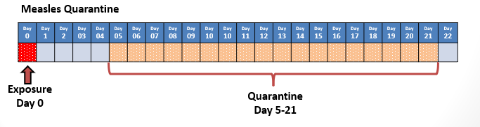
Measles In Review – Exposed Contacts
Measles Summary
Contacts with Evidence of Immunity do not need to quarantine:
  2 doses of MMR Vaccine
  Lab test showing immunity or Lab evidence of previous disease.
  Birth before 1957 (non-HCWs)
Quarantine for Susceptible Contacts: Day 5 through 21 following exposure. Exposure = Day 0.
  Vaccine: Post Exposure MMR within 72 hours may prevent disease (and quarantine requirements).
  Immune Globulin: IG may prevent or modify measles in persons who are nonimmune, if given within 6 days of exposure

Slide 42
Resources
Measles-Specific Resources
  The Epidemiology and Prevention of Vaccine-Preventable Diseases, a.k.a. the “Pink Book,” Chapter on Measles
  CDC Measles Chapter
  Measles for Healthcare Providers
  WHO Information on Measles
MDPH Division of Epidemiology and Immunization: 617-983-6800
  Questions/Guidance for follow-up
  Sample Letters/Alerts
  Reporting
MAVEN Help Desk: 617-983-6801
MDPH Reference Materials
  MDPH Guide to Surveillance, Reporting, and Control: Disease-Specific Chapters
  The Massachusetts Immunization Information System (MIIS) Onboarding and Resources:
  105 CMR 300.00: Reportable diseases, surveillance, and isolation and quarantine requirements
Notes:
OK, we’ve talked about a lot here. Ultimately, give us a call if you have any questions, particularly if you are wondering what actions to take with the information you have gathered.

Slide 43
What is Mumps?
Cause: paramyxovirus (Mumps Virus)
Transmission: droplet transmission
Symptoms: Primary Symptom is swollen salivary glands (parotitis)
  Prodromal Symptoms: fever, headache, fatigue ,myalgia, anorexia, earache, sore throat, nasal congestion, stiff neck
  Asymptomatic! (20% unvaccinated)
Incubation period: 16-18 d post- exposure (range 12-25 d)
Infectious Period: 2 days before swelling onset through 5 days after onset.
Recovery: about 2 weeks
Day 0
Onset of swelling
-2
-1
+1
+2
+3
+4
+5
https://www.cdc.gov/mumps/about/signs-symptoms.html
Notes:
So what exactly is mumps? Mumps is caused by the mumps virus and is a systemic disease that is most easily recognized by the swelling of one or more salivary glands, usually the parotid glands. Parotitis tends to occur early and may begin as an earache or pain upon touching. Symptoms usually start to recede after a week and are usually completely resolved after ten days. Many people experience a non-specific prodrome that can include myalgia, anorexia, malaise, headache, and low-grade fever.
Interestingly, about 1/3 of mumps infections do not cause apparent salivary gland swelling and may be asymptomatic, or may manifest primarily as a respiratory tract infection. Orchitis (testicular swelling) is the most common complication in postpubertal males.
The infectious period is considered to be two days before the onset of swelling, out to five days after onset of swelling, with onset of swelling counted as Day Zero. We will get more into this in a few slides, but this is important to remember.

Slide 44
Mumps in Massachusetts
MA Confirmed and Probable Mumps Cases
Disease | 2014 | 2015 | 2016 | 2017 | 2018 | 2019 | 2020 | 2021 | 2022 | 2023 | 2024*
Mumps² | 5 | 6 | 258 | 192 | 44 | 64 | 19 | 2 | 9 | 7 | 14
*Data as of 12/31/2024
2016: Largest Mumps outbreak in MA in 30+ years: out of 789 total investigations 258 confirmed and probable.
  2021: Lowest number of mumps cases in MA in over a decade.
* 2024 data is preliminary (12/30/24).
Notes:
Many of you have had suspect mumps investigations already. While we deal with them daily here at the state level, we realize that some towns rarely investigate mumps cases, or have never had one at all. The slides to this talk are posted in MAVEN Help, and are a resource to MAVEN users/case investigators.

Slide 45
Challenges of Mumps Testing
Negative Mumps Test ≠ No Mumps
Reasons
  Mumps virus sheds intermittently, so PCR testing may miss it
  Very difficult for a person who has been vaccinated (MMR vaccine) to mount an IgM response
Recommendation
  Recommend cases stay in isolation through their potential infectious period even if their results are negative.
Exception
  The only time a mumps case will be revoked is if an alternate diagnosis is given by the provider, or if the case does not meet clinical case definition (i.e. did not have at least 48 hours of swelling)
Notes:
Before we begin talking about specific testing methods, we want to make clear from the beginning that there is NO rule-out testing for mumps. This is an annoying fact we have to deal with during these investigations, and is a fact that is not often well understood or known by providers and the public alike.
There are a couple of reasons why we can’t rule out mumps based on a negative test result. First, the mumps virus can shed intermittently. This is problematic because a person may be clinically showing signs of mumps, but the virus may not be shedding right at the time the patient is tested, meaning the test will come back negative if it was a swab (even though the person may really have mumps). Additionally, because we have a vaccine for mumps (yay MMRs!), most people are vaccinated against the disease. It is very difficult for someone who has been previously vaccinated to mount an IgM response, so likely the blood testing will likely come back negative as well (again, even if the person really does have the disease).
Because of this unfortunate reality, we recommend that suspect cases of mumps stay in isolation through their potential infectious period, even if their results are negative. This is especially important in an outbreak setting, such as the outbreak among area colleges, because the likelihood is that these people really do have mumps. However, even in lower suspect cases, we want to make sure that on the off chance they do have mumps, it isn’t being spread around any further just because the testing came back negative.
On that note, the ONLY time a mumps case can be fully revoked in MAVEN is when an alternate diagnosis is given by the provider, or if the case did not meet the clinical case definition for mumps. I will go over this in more depth later too.

Slide 46
Measles, Mumps, and Rubella (MMR) Vaccination
There are now TWO MMR vaccines available for use in US!
  KEY UPDATE: Both vaccines are fully interchangeable for all indications for which MMR vaccination is recommended:
M-M-R II manufactured by Merck (Previous only US option available since 1978)
PRIORIX manufactured by GSK (Licensed June 2022)
MMRV Combination Vaccine: Children may also get MMRV (measles, mumps, rubella, & varicella) licensed for use 12 months through 12 years of age.
    ProQuad manufactured by Merck (MMRV licensed 2005)
CDC MMWR: MMR Vaccine (PRIORIX) ACIP Recommendations Nov. 18, 2022.
Notes:
Two doses of mumps vaccine are 86% (range: 32% to 95%) effective at preventing mumps.
One dose is 72% (range: 49% to 91%) effective at preventing mumps.
There are now TWO MMR vaccines available for use in US!
KEY UPDATE: Both vaccines are fully interchangeable for all indications for which MMR vaccination is recommended:
M-M-R II manufactured by Merck (Previous only US option available since 1978)
PRIORIX manufactured by GSK (Licensed June 2022)
MMRV Combination Vaccine: Children may also get MMRV (measles, mumps, rubella, & varicella) licensed for use 12 months through 12 years of age.
ProQuad manufactured by Merck (MMRV licensed 2005)

Slide 47
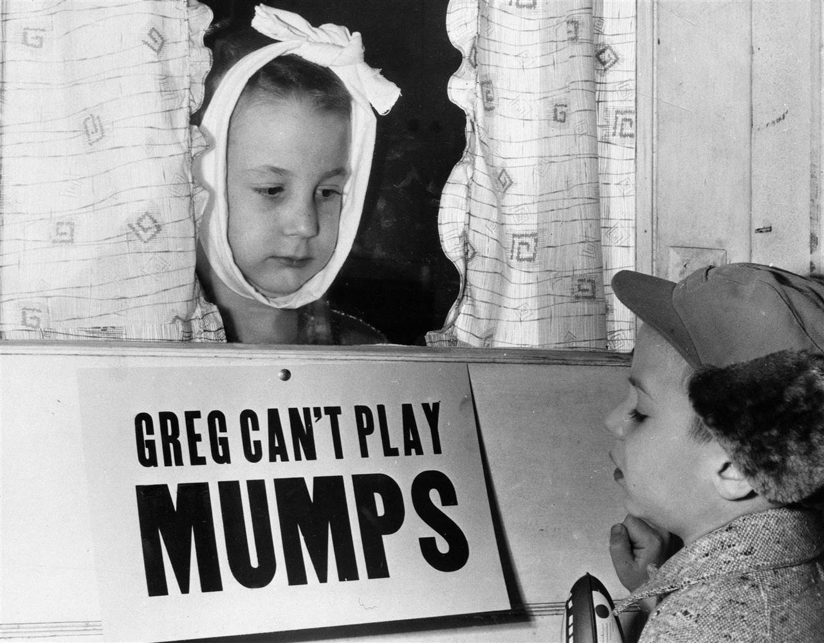
Mumps Control Measures
Notes:
So how do we control mumps from spreading further?

Slide 48
Control Measures
Control measures are the responsibility of LBOHs.
Confirmed and probable cases of mumps require control measures.
  If a suspect case is NOT lab confirmed, there are no formal control measures for contacts from public health, however,
    Providers can use clinical judgment for household contacts, etc.
    It is always a good time to get Up-to-Date with MMR Vaccine if needed! Patients should remain in isolation
Notes:
As with most communicable diseases in MA, control measures are typically the responsibility of LBOH. For mumps, confirmed and probable cases of mumps require control measures. If a case is not lab confirmed, there are no formal control measures for contacts of cases from public health. That being said, providers can use clinical judgement for household contacts, etc. And, to reiterate, even suspect cases of mumps should remain in isolation.

Slide 49
Control Measures
Key Prevention: Isolation and physical distancing (esp. dense setting).
Remember “Negative Mumps Test ≠ No Mumps,” therefore even if patients with clinical symptoms have negative results, they should still be isolated.
MMR Vaccination (88% effective preventing mumps): Ensure all contacts are up to date with their MMRs.
Exposed unvaccinated individuals should be excluded (Day 12-25 following exposure Day 0)
Notes:
So the main way to control mumps is through isolation and social distancing. This is especially important in settings like schools or other dense living areas, where there are a lot of people living together and having multiple opportunities to spread mumps.
MMR vaccination is the best protection we have against mumps. Ensuring that the population you care for is UTD with their MMRs is extremely important. Although mumps vaccination is considered to be about 88% effective, it is thought that even if it doesn’t prevent someone from developing disease, it likely reduces the severity and risk of complications from the disease.
There is no prophylaxis for mumps- POST-EXPOSURE MMR vaccination likely will not prevent mumps from developing in someone who has already been exposed, but will help for future outbreaks.
And finally, exclusion may be necessary. People with zero doses of mumps containing vaccine should be excluded from beginning on day 12 after exposure through day 25. We will go over this again later on in the presentation.

Slide 50
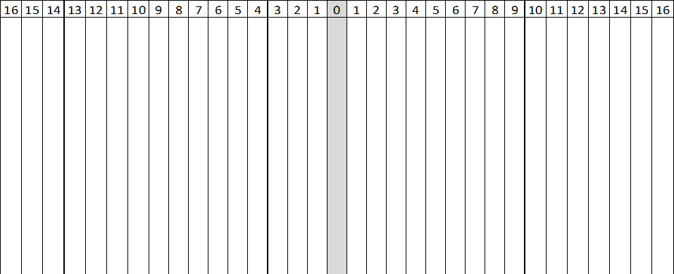
Mumps Infection Timeline
Swelling Onset
(Day Zero)
INCUBATION PERIOD:
Average is 16-18 days (range 12-25 days) to swelling onset
25 d
PRODROME:
3-5 days
myalgia, anorexia, malaise, headache, and low-grade fever
SWELLING: Lasts an average of 7-10 days; Parotid swelling may be noted as an earache or pain on palpitation at the angle of the jaw either unilaterally or bilaterally. May also present as orchitis or oophoritis
INFECTIOUS PERIOD: 2 days before to 5 days after swelling onset
ISOLATE CASE: through 5 days after swelling onset
Notes:
So here is a timeline showing how mumps infection and case investigation develops over time. A person can be incubating mumps from anywhere between 12-25 days before swelling begins, with the average being between 16-18 days. Those who experience a prodrome will typically begin feeling ill 3-5 days before swelling begins. Then, boom, swelling begins and we are at “Day Zero”. The swelling usually lasts for about a week, possibly up to ten days. A person is considered infectious for a total of 8 days- 2 days before swelling onset, the day of swelling onset (day zero), and 5 days after swelling onset. The case should be isolated during this infectious period, as soon as mumps is suspected, and can return to public activities once the infectious period is over, even if the person still has symptoms.

Slide 51
LBOH Main Responsibilities During Mumps Investigations
PART 1: Investigating the Case (completing question packages in MAVEN)
  Interviewing Patient (while waiting for test results).
  Gathering Contact Information (getting ready for additional control measures)
PART 2: Instituting Control Measures
  Making sure patient is isolated.
  Planning next steps for contacts.
Notes:
So, as the LBOH who is investigating the case, there are two main areas of the investigation. The first one is investigating the case, so basically completing the question packages in MAVEN. These are extremely important both in helping us do the active investigation, but also because we report a lot of information to CDC and we need as much complete information as possible. In addition, we do our own data analysis here at the state, and the more data we have, the more useful it is to help us determine trends, etc. You, as the LBOH interviewing the patient, are in charge of collecting this information while we wait for test results.
The second area is the control measures . So, not only do we want to know about the case itself, but we also want to make sure that the infection doesn’t spread further. This information about contacts comes from your interview. You should collect this information while we wait for test results so we are ready to act when and if we need to.

Slide 52
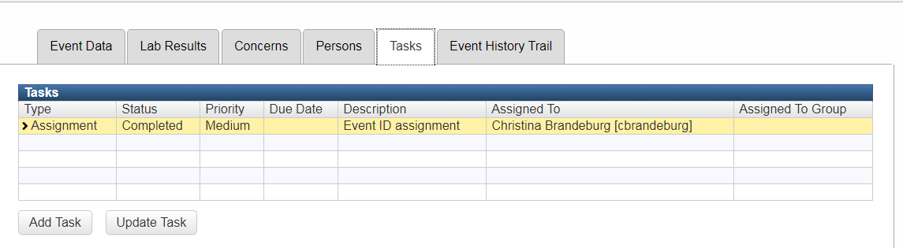
Step 1: Review and acknowledge event in MAVEN.
MAVEN
Mumps Investigation Steps
Typically, a suspect mumps event will be entered into MAVEN by an Epi at MDPH after receiving a phone call from a provider.
To see which MDPH Epi is assigned to the case, open the Tasks Tab and look under “Assigned To”.
Notes:
Okay, so let’s break the investigation down into more detail. The first step in a mumps investigation, as with all other investigations, is to review and acknowledge the event in MAVEN. Usually, a case is entered in by an MDPH epi who has received a call from a provider about a suspect case of mumps in their office. However, a suspect event can also come into MAVEN from a commercial lab (mostly with IgM results). In any case, the MDPH epi will put in as much information in the notes as they were able to obtain from the ordering provider about the patient.
Another helpful hint- if you want to know who the MDPH epi is who is assigned to the case look under the Tasks tab. The person who is assigned to the case and the person who created the case or took the initial phone call are NOT always the same person. So don’t just look to see who wrote the last note. If you have questions about the case, it is always best to direct them to the person who is actually assigned to the case, which is always in the tasks tab. When we go into the MAVEN training site, I’ll highlight this tab.

Slide 53
Step 2: Call case to collect important information for Case Report Form.
Mumps Investigation Steps
2023 Case Definition Change: Swelling of any duration
Questions to ask the Patient
Symptom History (Review the symptoms experienced, swelling onset date is critical) (QP #3)
MMR Vaccination History (if not already known from ordering provider)? (QP #4)
Occupation/school (if so, where and did they work/attend school while infectious)? (QP #2)
Race/ethnicity (if not known by provider)?
Risk History
  Contact with another case of mumps, or someone with similar symptoms? (QP #5)
  Travel History (including where and dates), or recent out of town visitors (from where and dates)? (QP #5)
  Any recent dental work? (No QP, but put in Notes)
  Transmission setting (childcare, school, healthcare setting)? (QP #5)
Risk History Time Period is generally one month (up to 25 days) prior to onset so we can hopefully determine where they may have been exposed to mumps (risk history).
Notes:
Since the provider has already been spoken with by an MDPH epi, the next step is to call the case (or case’s family) directly to collect important information needed for the case investigation. Confirm the clinical symptoms with the patient, and make sure to confirm the swelling onset date, which is a crucial piece of information for determining the infectious period.
Yes, typically there will already be some notes in the case from the epi who created it and spoke with the provider. But even if some of the information you need was already collected, it is important to re-ask the patient about their symptoms and risk. They may have a different answer than the provider. Sometimes what the provider said was a rough estimate, and you will have better luck getting exact dates and information from the patient directly. The providers don’t always ask their patients the right questions, and often the patient has already gone home by the time the doctor is calling the health department. So we at least need you to confirm the swelling onset dates directly.

Slide 54

Step 3: Identify all contacts who have been exposed.
Mumps Investigation Steps
Think about people in the following groups who were in close contact (within 6- feet) with the case during their infectious period or had direct contact with case’s respiratory secretions:
  Household members
  School/daycare
  Co-workers
  Staff and patients at medical facility where case was seen
  Religious/social groups
  Sports teams/other extra-curricular groups
  Bus/carpool mates
  Close friends
Exposure: Close Proximity for prolonged period of time and/or exposure to respiratory secretions.
Notes:
After you determine the infectious period, we can understand better who may be a close contact:
An exposure to mumps is anyone in close proximity for a prolonged period of time and/or exposure to respiratory secretions.
From there, we want to work with school nurses, parents, coaches, etc. to determine susceptibles…

Slide 55
Step 4: Identify Susceptibles
Mumps Investigation Steps
Susceptible to Mumps: People who do not have evidence of immunity, including those with vaccine exemptions.
Sufficient Evidence of Immunity to Mumps:
  Birth in the US before 1957 (unless a healthcare worker)
  Documentation of 2 doses of mumps containing vaccine
  Serologic evidence of immunity or laboratory evidence of disease
Verbal past history of disease is NOT acceptable evidence of immunity.
Notes:
After that, determine if there are any other susceptible. This basically means anyone who does not have evidence of immunity to mumps. Sufficient evidence of immunity to mumps is birth before 1957 in the US (unless a healthcare worker for which one of the other two are required), documentation of 2 doses of MMR, serologic evidence of immunity or lab evidence of disease. A verbal report of past history of disease is NOT acceptable evidence of immunity if it is not accompanied by laboratory evidence.

Slide 56
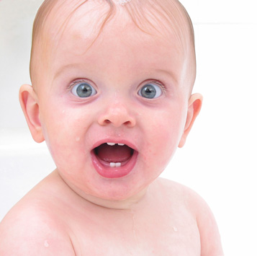
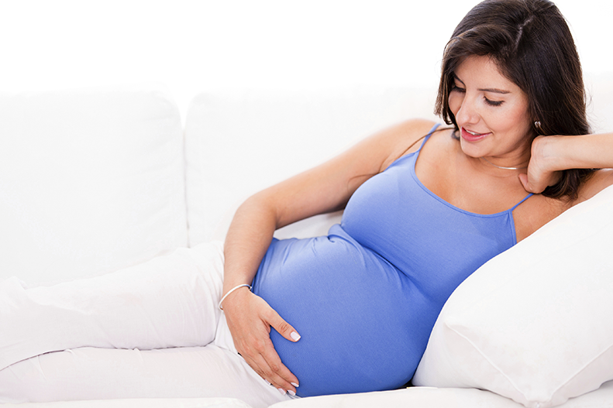
Step 4: Identify Susceptibles
Mumps Investigation Steps
Prioritize unvaccinated High-Risk Contacts and refer to healthcare providers.
  Pregnant women
  Immunosuppressed individuals
  Infants <12 months of age
Notes:
Once you have determined who was exposed, it’s time to figure out if any of those contacts are considered high risk, meaning they are pregnant, immunosuppressed, or infants under the age of 1 (and who cannot be vaccinated). Although there is no prophylaxis for these patients, it is always a good idea to have them let their own providers know they were exposed to mumps so that the clinician is in the loop and can provide clinical guidance.

Slide 57
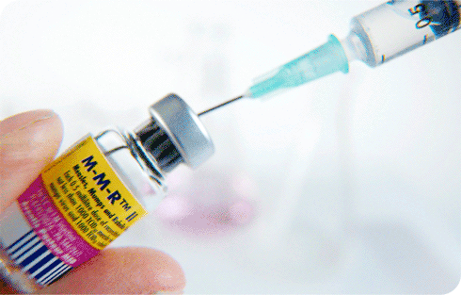
Step 5: Recommend immunization for all susceptibles >12 months of age for which MMR is not contraindicated
Mumps Investigation Steps
  Vaccinating an exposed individual who may be incubating mumps is not harmful
    The same applies to an individual who MAY have been vaccinated in the past but does not have a record of that vaccination.
  Reminder: As a LBOH, you can give MMR to exposed contacts (MDPH vaccine unit has doses of MMR available to LBOHs)
Notes:
Next, for all those susceptibles for which MMR is not contraindicated and who are not under the age of 1, vaccination with MMR should be recommended. Even if a person has already been exposed and could potentially be incubating the disease, vaccinating them is NOT harmful and should be done.
As a reminder, LBOH can give MMR to exposed individuals. The MDPH vaccine unit has MMR available to LBOH in outbreak settings so that susceptibles can be immunized if it’s determined that’s the best mechanism for getting people vaccinated. If you ever run into this situation, contact the epi program and we will work with the vaccine unit to get you doses of MMR.

Slide 58
Step 6: Discuss isolation dates and notifying contacts with case.
Mumps Investigation Steps
  Calculate infectious period with case and discuss how long they need to stay out of public activities.
    Infectious Period= 2 Days before Onset through 5 Days After.
      Swelling Onset = Day 0
  Develop a plan of action for household & other contacts
    You can work in tandem with them to notify exposed contacts as applicable.
Day 0
Onset of swelling
-2
-1
+1
+2
+3
+4
+5
Mumps Infectious Period
Notes:
Ideally, the ordering provider went over with the patient the need to isolate during their infectious period. However, the reality is this doesn’t always happen. It is important for you, as the LBOH, to reiterate to the patient the dates of their isolation period and when they can return to public activities. Also, work with them to notify contacts and develop a plan of action for household contacts. This typically involves having household members check in with their providers on their MMR status, and if it’s unknown or if they don’t have any, they should go and receive a dose as soon as possible.

Slide 59
Step 7: Follow up with school/workplaces and/or additional contacts if applicable.
Mumps Investigation Steps
  Mumps letter/advisory templates are available.
  Contact MDPH epidemiologists for assistance. Epi Program: 617-983-6800
Notes:
Sometimes, workplaces or schools will need to be notified of an exposure. MDPH has mumps letters and advisory templates to use for these situations, and we would be happy to work on these with you if you need them.

Slide 60
Step 8: Final Control Measures
Mumps Investigation Steps
  Case: Exclude through 5 days after onset of swelling
    Swelling onset is Day 0
  Contacts: Individuals without evidence of immunity should be excluded from Day 12-Day 25 after exposure.
    Exposure = Day 0.
    Post-exposure vaccination is not expected to prevent illness or development of disease in someone recently exposed to mumps. Rather, exposed individuals should be vaccinated to protect against subsequent exposures.
    In most low-risk settings, asymptomatic contacts can typically avoid exclusion if they receive a dose of MMR.
Notes:
The final step for control measures is to exclude anyone who does not have evidence of immunity and will not or cannot get a dose of MMR. In most low-risk settings, people who did not have acceptable evidence of immunity but receive an MMR will be allowed back to work/school (even though the person is potentially incubating mumps at that point). This is because the main goal is to increase immunization rates. However, in high-risk settings, like if the exposed contact is a healthcare worker or works in a daycare, etc, the person may not be readmitted, even if they do get a dose of MMR. Ultimately, it is up to your town, and some towns will be a little more strict with this. We are happy to talk you through it and our recommendations for a specific scenario.

Slide 61
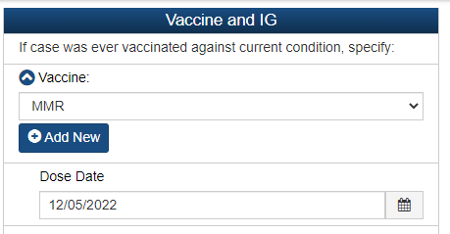
Step 9: Update all notes and fields in MAVEN
Mumps Investigation Steps
  Most important variables to complete are:
    Race/Hispanic Status (QP #2)
    Onset of swelling (QP#3)
    Duration of swelling (QP #3)
    Vaccination history (QP #4)
      Remember to ADD NEW for adding a second dose of vaccine.
Notes:
Also, just a reminder to please update all notes and the question fields in MAVEN! The notes section is very helpful, but it is required for the actual variables within the question packages to be completed as well. This may seem duplicative, but it helps tremendously when we are extracting and analyzing data from MAVEN and sending it down to CDC.
As mentioned before, some of the most important variables to complete are SOGI variables, race/ethnicity, vaccination history, onset of swelling, and duration of swelling. Remember, you can “Add new” so you can add all vaccine dates to the question package, which is very important.

Slide 62
Step 10: Sign off in Admin Question Package (QP)
Mumps Investigation Steps
  Once investigation is concluded and all data has been entered in the question packages, complete Steps 4 and 5 in the Administrative Question Package to sign off on the MAVEN event.
    Case Report Form = Complete for both confirmed and ruled out mumps cases if LBOH is able to enter required variables.
    Lost to Follow-up should only be utilized if no contact was made with the case.
  This signals for MDPH Epi that the case is ready for final review.
Notes:
And finally, sign off in the admin question package so that we know the case is ready for final review here at the state.

Slide 63
Are we still thinking mumps?
Epidemiological Indicators of Highly Suspect Mumps | Epidemiological Indicators of Low Suspect Mumps
Known contact with a confirmed Mumps Case Recent travel Sick contacts College student or active contact with the college community Dense communal living (dorm environment) Unvaccinated community Age range (late teens – 20s) where we see most cases. Classic symptoms (swelling > 48 hours) | No known risk (no travel, no sick contacts) Fully vaccinated Alternative diagnosis in differential Recent dental work/facial injury Young vaccinated child/older adult (not typical risk group) No contact with college students
Notes:
If the tests come back negative or inconclusive, these are things from your interview that help us determine if we still are highly suspicious it might be mumps, or if there is really nothing indicating it is mumps.
(alternative diagnoses often include swollen salivary gland, mono, even flu, etc.)

Slide 64
Resources
MDPH Division of Epidemiology and Immunization: 617-983-6800
  Questions/Guidance for follow-up
  Sample Letters/Alerts
  Reporting
MAVEN Help Desk: 617-983-6801
MDPH Reference Materials
  MDPH Guide to Surveillance, Reporting, and Control: Disease-Specific Chapters:
    https://www.mass.gov/handbook/guide-to-surveillance-reporting-and-control
  The Massachusetts Immunization Information System (MIIS) Onboarding and Resources:
    https://www.miisresourcecenter.com/
  105 CMR 300.00: Reportable diseases, surveillance, and isolation and quarantine requirements:
    https://www.mass.gov/regulations/105-CMR-30000-reportable-diseases-surveillance-and-isolation-and-quarantine-requirements
Notes:
OK, we’ve talked about a lot here. Ultimately, give us a call if you have any questions, particularly if you are wondering what actions to take with the information you have gathered. Again, we depend on you to interview the patient directly, make sure they are isolated, and to get as much information from them as possible. Next steps depend on what information you gathered, and the test results coming in. I know it is a lot, so let’s see if there are any questions before we move on to measles.

Slide 65
Your Questions?

Slide 66
Rubella
Rubella is no longer endemic in the United States but can be brought into the United States by people who get infected in other countries.
Rubella is usually mild but can cause:
  Low-grade fever
  Sore throat
  A rash (starts on the face and then goes to other parts of the body)
  Arthritis (70% of women)
Rubella can cause miscarriage or serious birth defects.
One dose of MMR vaccine is 97% effective against rubella.

Slide 67
Rubella
The most common reason for “reports” of rubella are when providers accidentally order IgM for immunity screening purposes.
The Epidemiologist of the Day at the state will follow-up with the ordering providers and/or employee health to see if rubella was truly suspected.
If testing was conducted for immunity screening only, or was not ordered intentionally, and the patient is not pregnant and does not have symptoms of rubella, the case will be revoked.
If rubella is suspected and/or positive result is from a pregnancy screen the state epi will work on obtaining information and working with local board of health.
True suspect/cases of rubella are extremely rare.

Slide 68
That was a lot of information!
So, what are your questions?

