Slide 1



A Nicotine Free Community
A policy to pave the way for a nicotine free generation
Department of Public Health - Melrose
Mystic Valley Public Health Coalition
Notes:
Hello – This presentation will focus on the dangers of tobacco products & a solution that may help our future generation

Slide 2
The Policy
Brookline, MA is the 1st community to adopt this policy
No person, firm, corporation, establishment, or agency shall sell tobacco or e-cigarette products to anyone born on or after 1/1/2000.
Goal: To phase out nicotine purchasing over time.
Notes:
The solution was inspired by Brookline, MA. They were there first community in the country to adopt a policy that will phase out nicotine purchasing in their town over time. For example: You need to be 21 to purchase tobacco products; however, if you’re are not 21 before January, 2000 then you cannot purchase tobacco in Brookline.
I would like to continue with the presentation on answering “why” our solution should be supported.

Slide 3

Why is it important to become a nicotine free community?
Answer:
To assist with the growth and development of our youth and young adults in the community.

Slide 4

Why is it important to assist the growth and development of youth and young adults?
Answer:
Youth and young adults are the future of our country.
We must act to help protect them from the harmful effects of nicotine products.

Slide 5

Why is it important to protect youth and young adults from nicotine products?
Every day, more than 1,200 people in this country die from smoking related diseases
(U.S. Department of Health and Human Services, 2021b; STOP, 2023)

Slide 6
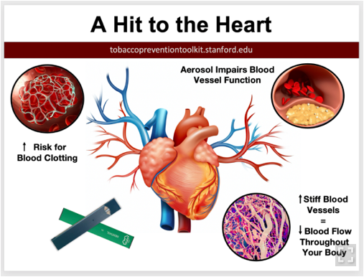
Early heart and blood vessel disease
(U.S. Department of Health and Human Services, 2021b; STOP, 2023)

Slide 7
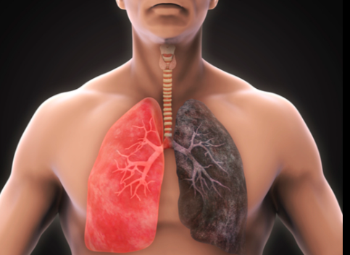
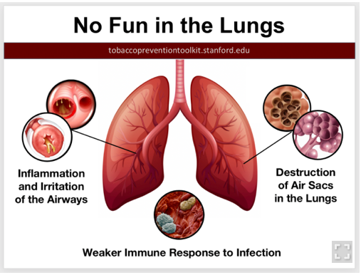
Smoking harms the Lungs!
(U.S. Department of Health and Human Services, 2021b; STOP, 2023)

Slide 8

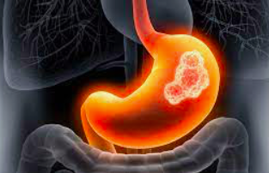

Causes Cancer!
(U.S. Department of Health and Human Services, 2021b; STOP, 2023)

Slide 9


Increase levels of depression, anxiety, stress and psychiatric symptoms
(U.S. Department of Health and Human Services, 2021b; STOP, 2023)

Slide 10


Why is it important to protect youth and young adults from nicotine products? (Continued)
The Target
600,000 middle school students and 3 million high school students' smoke
(U.S. Department of Health and Human Services, 2021b)
Notes:
It’s important to protect the youth and the young adults from nicotine products because – this is who The tobacco industry targets. In a recent survey by the U.S. Department of Health and Human services found that 600,000 middle school students and 3 million high school students' smoke
Let’s explore why…

Slide 11

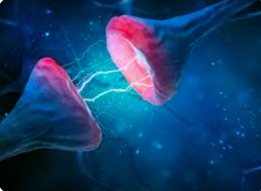

Why is it important to protect youth and young adults from nicotine products? (Continued)
Addiction
Tobacco Products may be considered as a Gateway drug
(KnowTheRisk, 2023; Tiwari et al. 2020)
Notes:
It is much more difficult for an young adult to quite than a adult who started tobacco products in adulthood.

Slide 12
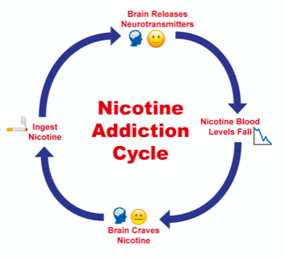
Withdrawal from Nicotine
Feeling irritable, restless, or jittery
Feeling sad or down
Feeling anxious
Feeling tired or groggy
Having trouble thinking clearly or concentrating
Having trouble sleeping
Feeling hungry
Having intense cravings for nicotine
(SmokefreeTeen)

Slide 13
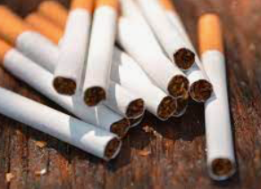


Slide 14

Notes:
E-cigarettes are devices that heat a liquid into an aerosol that the user inhales.

Slide 15
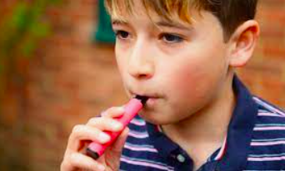



Slide 16
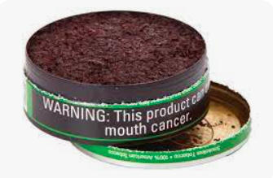

Slide 17
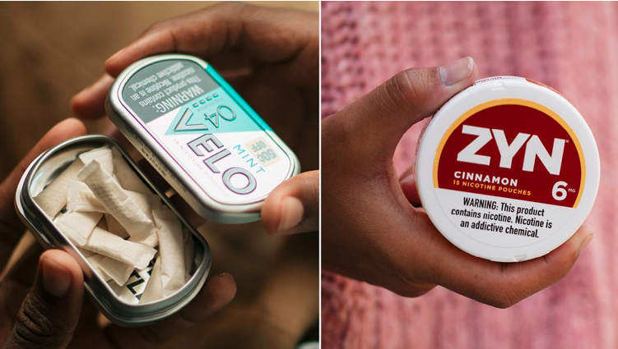


Slide 18
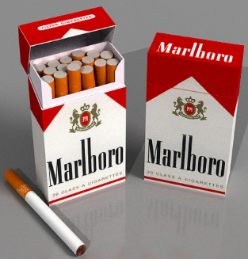
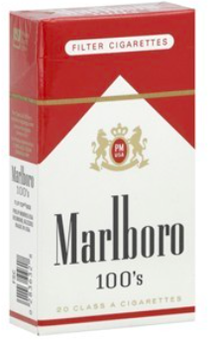
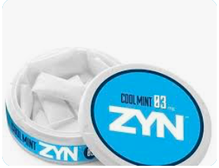



Let’s Compare
Notes:
Let’s Compare
20 single cigarettes = 1 pack of cigarettes
1 standard cartridge for one vape pen = 1 pack of cigarettes
1 tin of Nicotine Pouches (10) = 2.5 packs of cigarettes
Keep in Mind
The liquids for vaping & Zyn Pouches
can come in higher concentrations which increases
the likelihood of addiction!!!

Slide 19

Why do we want to help prevent nicotine addition?
Answer:
We want the youth and young adults to be able to live their best quality of life without having barriers to being productive-adults

Slide 20




Why?
Everything has a price but there is no price on a child’s life or future.
Notes:
It’s important to help the youth & young adults stay
in engage in their everyday life and function for
years to come within their community.

Slide 21
References
Lyytinen, G., Brynedal, A., Anesäter, E., Antoniewicz, L., Blomberg, A., Wallén, H., Bosson, J., Hedman, L., Mobarrez, F., Tehrani, S., & Lundbäck, M. (2023). Electronic cigarette vaping with nicotine causes increased thrombogenicity and impaired microvascular function in healthy volunteers: A randomised clinical trial. Cardiovascular Toxicology, 23(7–8), 255–264. https://doi.org/10.1007/s12012-023-09802-9
KnowTheRisk. (2023). Risk. U.S. Department of Health and Human Services. https://e-cigarettes.surgeongeneral.gov/knowtherisks.html#:~:text=Youth%20and%20young%20adults%20are,permanent%20lowering%20of%20impulse%20control.
STOP. Smoking, nicotine and the Global Mental Health Crisis. STOP. (2023, June 13). https://exposetobacco.org/news/smoking-nicotine-mental-health/
Rose, J. , Krishnan-Sarin, S. , Exil, V. , Hamburg, N. , Fetterman, J. , Ichinose, F. , Perez-Pinzon, M. , Rezk-Hanna, M. & Williamson, E. (2023). Cardiopulmonary Impact of Electronic Cigarettes and Vaping Products: A Scientific Statement From the American Heart Association. Circulation, 148 (8), 703-728. doi: 10.1161/CIR.0000000000001160.
Tiwari, R., Sharma, V., Pandey, R., & Shukla, S. (2020). Nicotine addiction: Neurobiology and mechanism. Journal of Pharmacopuncture, 23(1), 1–7. https://doi.org/10.3831/kpi.2020.23.001
U.S. Department of Health and Human Services. (2021b, March 12). Preventing tobacco use among youths, surgeon general fact sheet. https://www.hhs.gov/surgeongeneral/reports-and-publications/tobacco/preventing-youth-tobacco-use-factsheet/index.html

