Slide 1

TFG explained
The
What, Who, Why and How
of
Tobacco-Free Generation policies

Slide 2
What
Policies target sales of addicting nicotine products
Smoke-Free Generation → cigarettes only
Nicotine-Free Generation → all commercial nicotine
TFG is the generic term for all possibilities:
May include cigars, pipes, shisha, heat-not-burn, e-cigs, vapes, pouches, etc.

Slide 3
Who
Policies target commercial suppliers to those born after a certain birthdate
(e.g. Jan 1, 2010)
‘Commercial supply’ includes freebies at youth venues
No targeting of purchase, use or possession

Slide 4

Why
Tobacco kills
most of its long-term users
Nicotine is highly addictive
Most who start become
long-term users
Focus on preventing initial use
Banning sales to addicted is
risky in large jurisdictions

Slide 5
Why (ctd)
Almost no one starts tobacco use post-adolescence
Focus on preventing initial use by youth
Youth want to appear grown-up
Avoid minimum age laws that signify maturity
Laws send messages
Lifetime constraint signals ‘no safe age for tobacco’

Slide 6
How
Choose an appropriate birthdate
Minimize the number of nicotine-dependent affected
No denied addicted consumers → no black market
Enhance cessation efforts
To help the few youngsters already addicted
For older folk affected by tobacco denormalization
Simplify enforcement
By licencing vendors, with penalties for illegal sales

Slide 7
FAQ
Do retailers need to sell tobacco products?

Slide 8
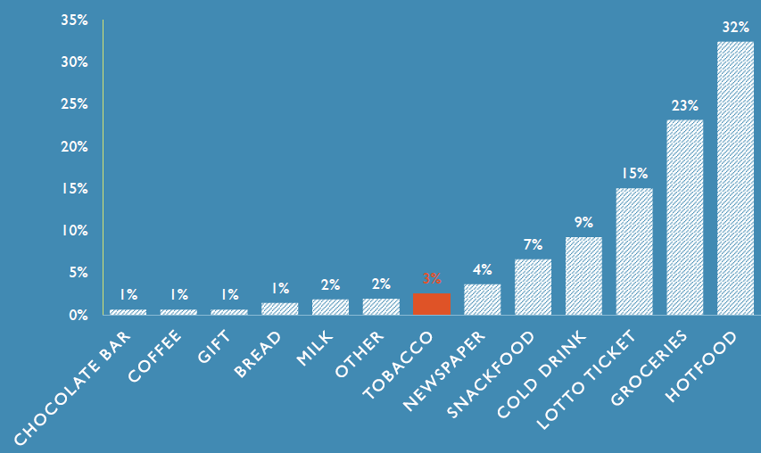
Main reason for visiting small tobacco retailer
A/Prof Lisa Wood Univ WA 2019
Notes:
[Hitchman et al 2016 https://www.ncbi.nlm.nih.gov/pmc/articles/PMC5690267]
80% of small retailers in England believe the footfall myth, but
[Wood & Gazey 2021 https://tobaccocontrol.bmj.com/content/tobaccocontrol/early/2021/04/07/tobaccocontrol-2020-056310.full.pdf]
in WA found only 3% of customers of small tobacco retailers visited to buy tobacco products!

Slide 9
Philip Morris internal document (1994):
‘economic arguments often used by the industry to scare off smoking ban activity … simply had no credibility with the public,
which isn’t surprising when you consider that our dire predictions in the past rarely came true.’

Slide 10
FAQ
Is a birthdate rule discriminatory?

Slide 11

Sometimes, discrimination is the fairest option
To phase out a toxic product,
it’s necessary to draw a line in the sand.
Where the benefit outweighs the harm,
as in the case of ending tobacco sales,
this line in the sand is justified.
Image: Anne Dennish

Slide 12
FAQ
Has such a law been used already?

Slide 13
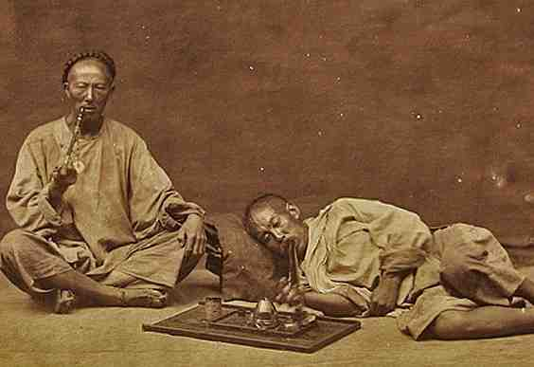
Tried before?
Yes! For opium smoking last century
Formosa : 80% reduction in 15 years
Ceylon : eradicated within 35 years
Ref: Willoughby (Johns Hopkins, 1925)
Report of the Prohibition Commission (Ceylon,1957)
Notes:
Tobacco industry attempts to liken TFG to alcohol prohibition are a red herring – TFG is not an overnight prohibition, and alcohol is very different from tobacco.
A more accurate model is that, early last century, both Japanese Formosa and British Ceylon introduced a similar measure to eradicate widespread opium smoking (highly addictive, like tobacco with which it was often mixed).
They allowed existing addicts to continue (no cold turkey), but denied sales to those not addicted prior to the law change.

Slide 14
FAQ
How long does TFG take to succeed?

Slide 15
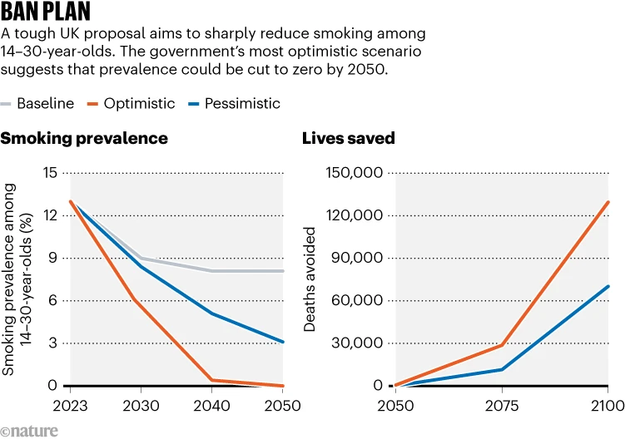
UK government modelling

Slide 16
FAQ
Is TFG politically popular?

Slide 17
TFG public support
Location | Date | For | N | Support | Oppose
Singapore | Aug-07 | National Cancer Centre | 500 | 70.4%
Australia | Aug-12 | News Limited -- online | 2,595 | 67.9%
Australia | Aug-12 | Fairfax Media -- online | 29,096 | 73.2%
Tasmania, Australia | Dec-13 | Cancer Council | 1,200 | 75.0%
Canada | Jun-14 | Toronto Globe & Mail |  | 72.2%
Spain | 2021 | Nofumadores | 5,305 | 84.0%
France | 2021 | Alliance Contre le Tabac (ACT) | 1,000 | 86.0% | 14.0%
New Zealand | Sep-23 | ITC Youth & Young Adult Survey | 3,414 | 79.0% | 14.0%
UK | Nov-23 | ASH (UK) | 4,107 | 66.0% | 14.0%
Ireland | Nov-23 | Irish Heart Foundation | 1,012 | 76.0% | 22.0%
Italy | Mar-24 | IRCCS, Milan | 22,428 | 74.1% | 18.0%
UK | Apr-24 | ASH (UK) | 13,266 | 69.0% | 12.0%
NB: Actual questions asked, and sampling methodologies used, may vary.

Slide 18
FAQ
Is TFG spreading?

Slide 19
TFG progress
Location | Passed | Start | Birthyear | Restricted | TI pushback
Balanga, Philippines | Sep-16 | Sep-16 | 2000 | all nicotine | courts
Brookline MA, US | Nov-20 | Sep-21 | 2000 | all nicotine | courts
Malaysia | “Dec-22” |  | 2009 | smoked | ? election
New Zealand | Dec-22 | repealed | 2009 | smoked | party contacts
Stoneham MA, US | Mar-24 | Jan-25 | 2004 | all nicotine
Wakefield MA, US | Mar-24 | Jan-25 | 2004 | all nicotine
UK | “Nov-24” |  | 2009 | smoked
Melrose MA, US | Apr-24 | Jan-25 | 2004 | all nicotine
Winchester MA, US | May-24 | Jan-25 | 2004 | all nicotine
Malden MA, US | May-24 | Jan-25 | 2004 | all nicotine
Reading MA, US | June-24 | Jan-25 | 2004 | all nicotine
Concord MA, US | Oct-24 | Jan-25 | 2004 | all nicotine
Manchester MA, US | Oct-24 | Apr-25 | 2004 | all nicotine
Chelsea MA, US | Dec-24 | Jan-25 | 2004 | all nicotine
Belchertown MA, US | Dec-24 | Jan-25 | 2004 | all nicotine
Needham MA, US | Dec-24 | Jan-25 | 2004 | all nicotine

Slide 20
World Health Organisation (WHO) (2004)
‘The best law
is one that so shapes social norms
that it becomes self-enforcing.’
Notes:
Seat belt legislation is one example of a law that has guided social norms.
20

